Slide 1
Educational Program Advisor Lv-273.NET

Slide 2









TEAM TEAM TEAM

Slide 3



Slide 4
Problem statement
Problem : Every year school graduates face the problem of choosing a higher educational institution.
What specialty to choose?
What university to enter?
Users : School graduates and their parents, who are deciding which university to choose.
Solution : Web application that contains list of all universities with details, pass professional orientation tests, specialties selection algorithms.

Slide 5

User roles
Admin
Registered User
Visitor

Slide 6
Visitor functionality
View list of universities, specialties with detailed information
View TOP universities
Pass professional orientation tests
Auto generation of specialty list where he can apply documents
Registration
Authorization

Slide 7
Registered user functionality
Visitor functionality +
View an account where personal data can be showed
Change password
Add to wish list interested specialties
Save professional orientation tests result

Slide 8
Analogues

Slide 9
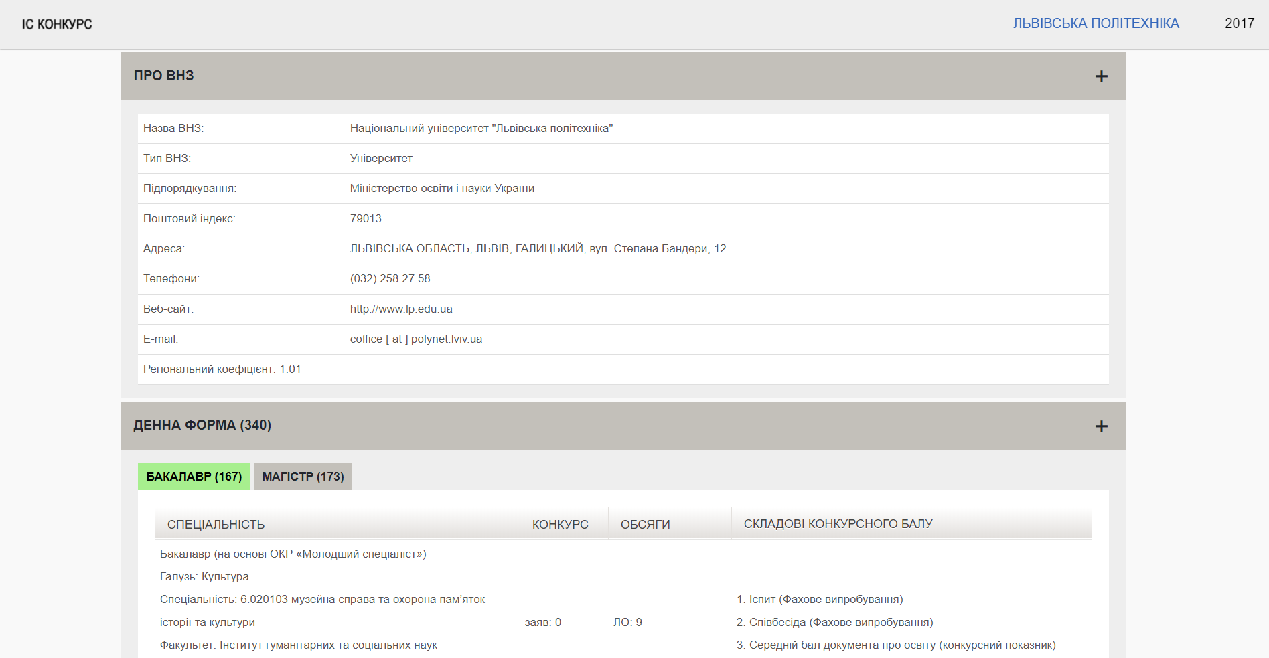
Vstup.info

Slide 10
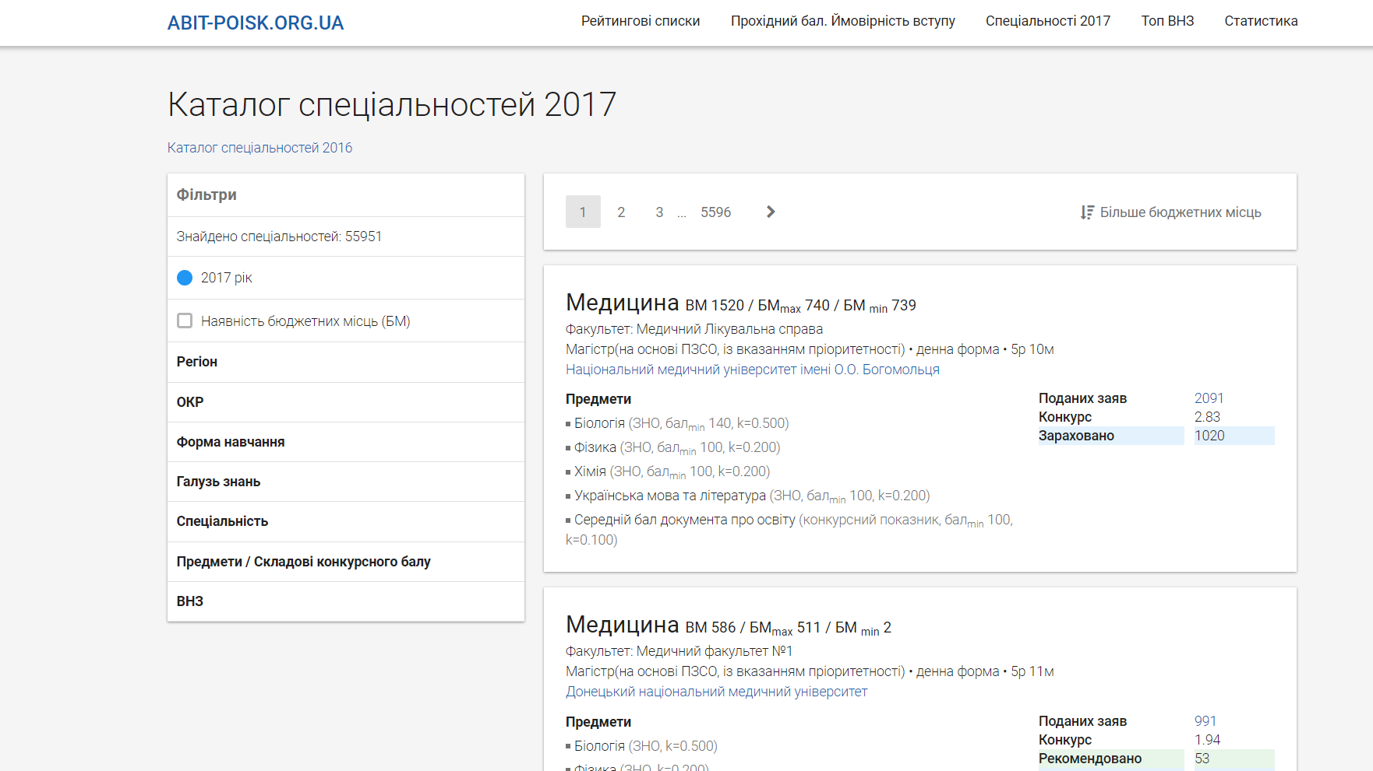
Abit-poisk.org.ua

Slide 11

















Technologies we use
SCRUM

Slide 12
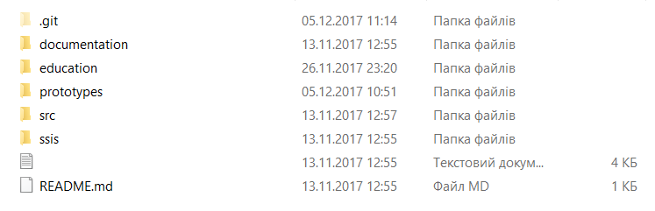
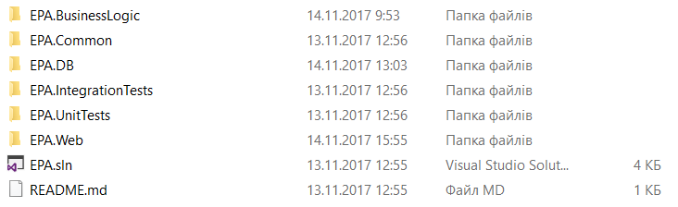
Solution architecture

Slide 13
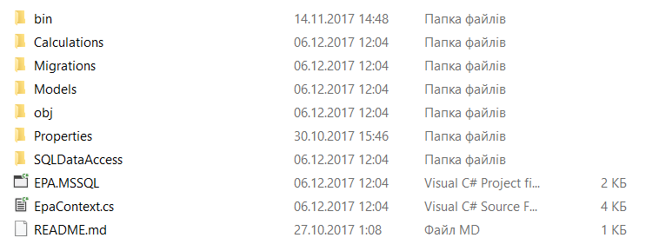
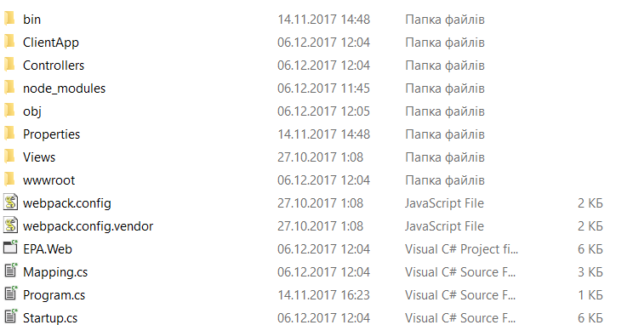
EpaDB
EpaWeb

Slide 14
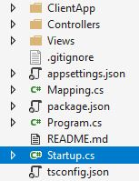
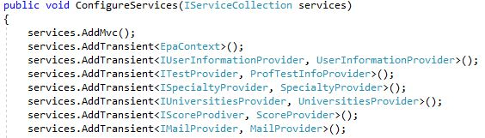
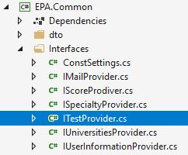
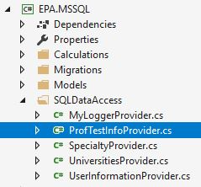
Anastasiya
Dependency injection

Slide 15
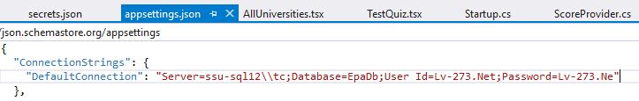
Anastasiya
User Secret Store
Solution?

Slide 16
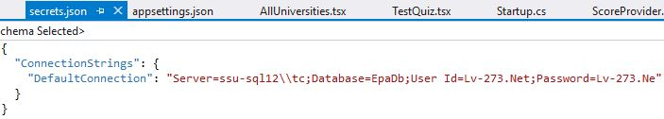
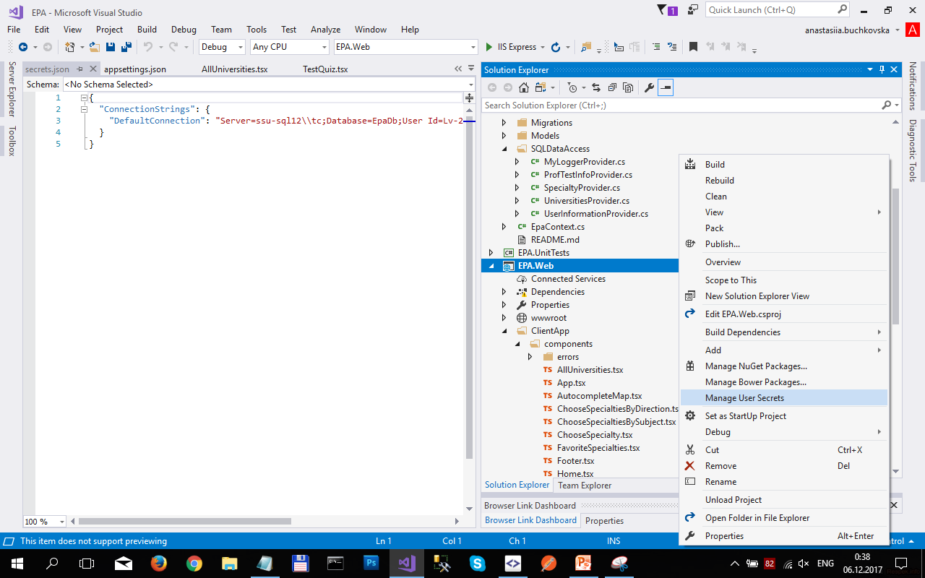
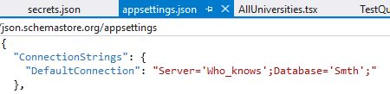
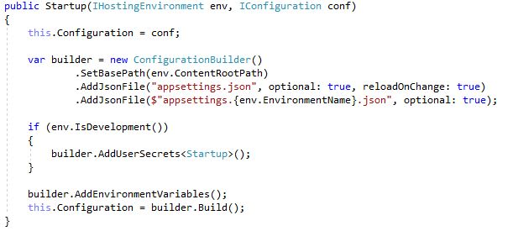
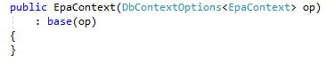
Anastasiya

Slide 17
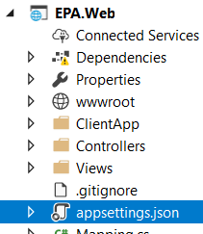
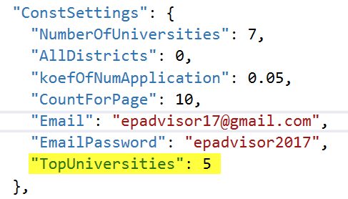
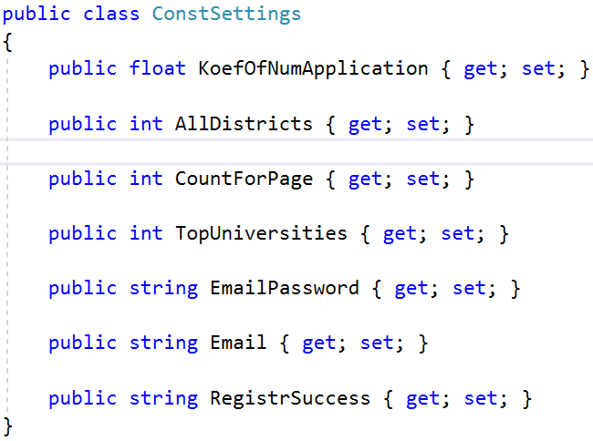
Nataliia
Configuration

Slide 18
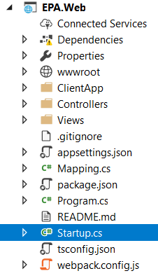
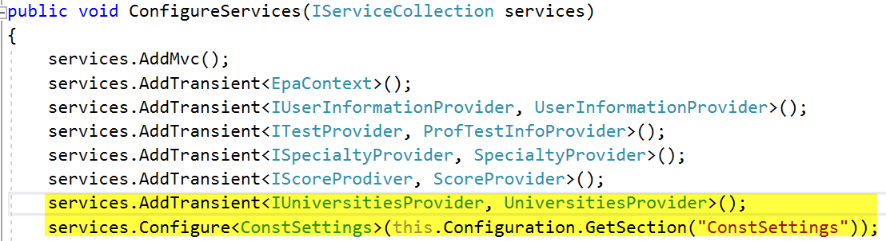
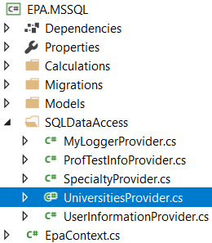
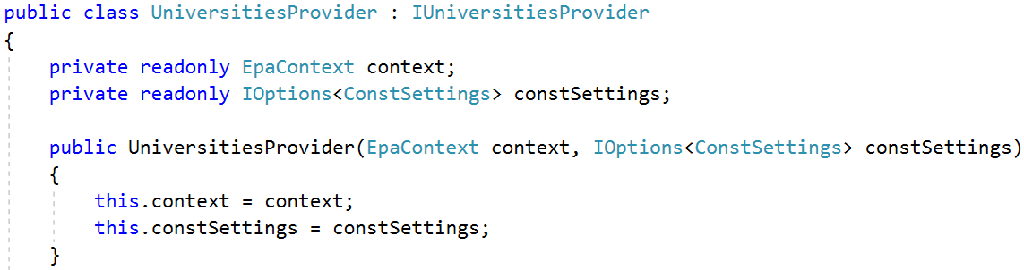
Nataliia
Configuration

Slide 19
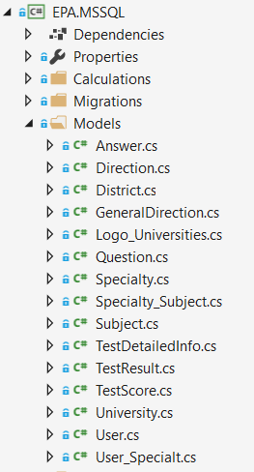
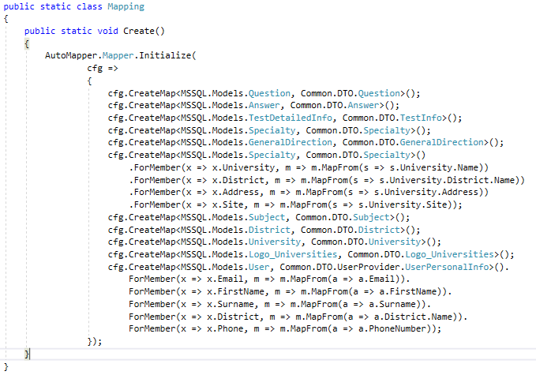
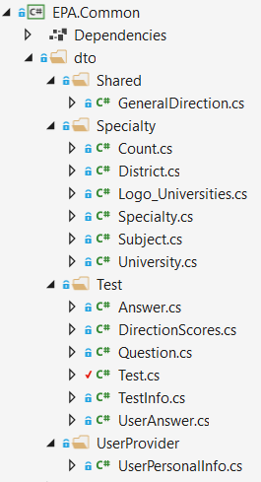
Anastasiya
Iryna
DTO

Slide 20
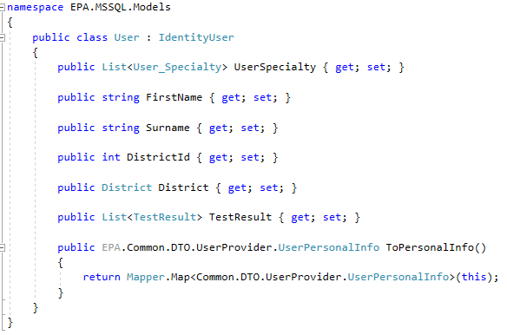
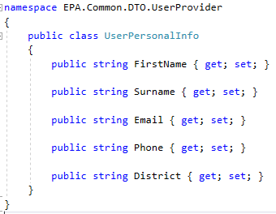
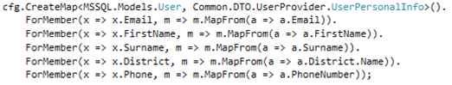
Anastasiya
Iryna
DTO Example

Slide 21
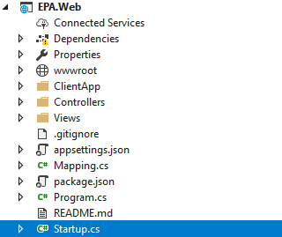
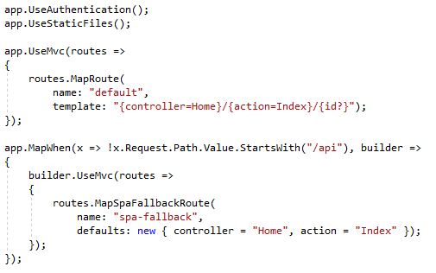
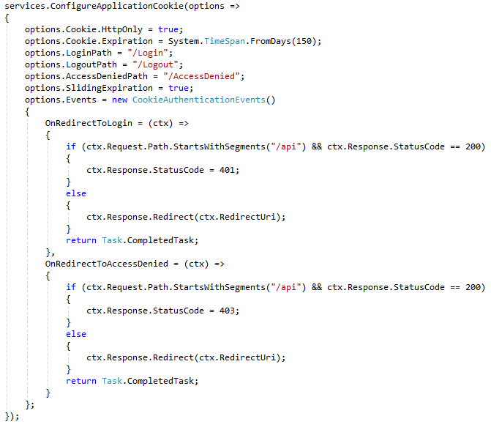
Vanya
Cookies & Routes in Startup.cs

Slide 22
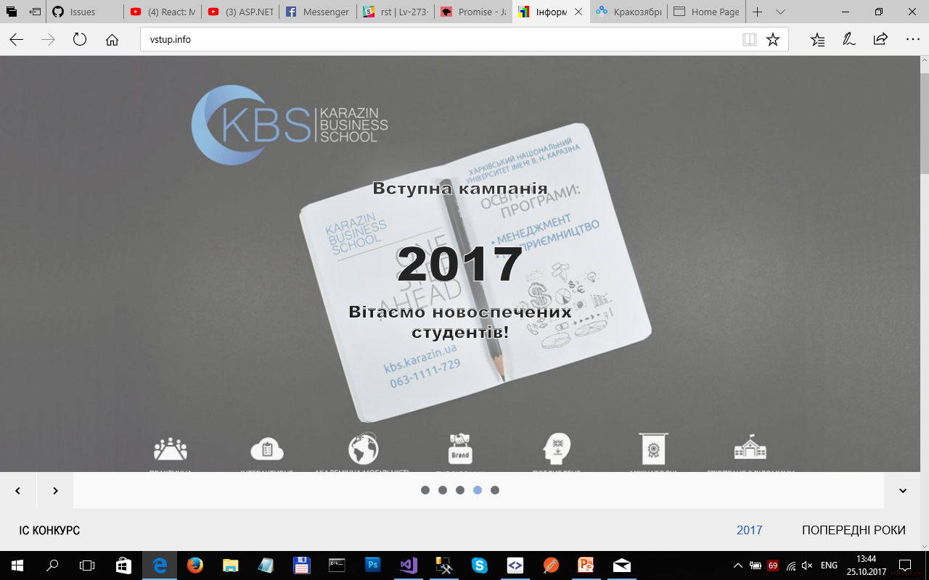

Andriy
Data integration
To fill data base tables that contain information about universities and their specialties, we created additional ETL service that parses information from site “vstup.info” and it will run periodically.
MSSQL

Slide 23
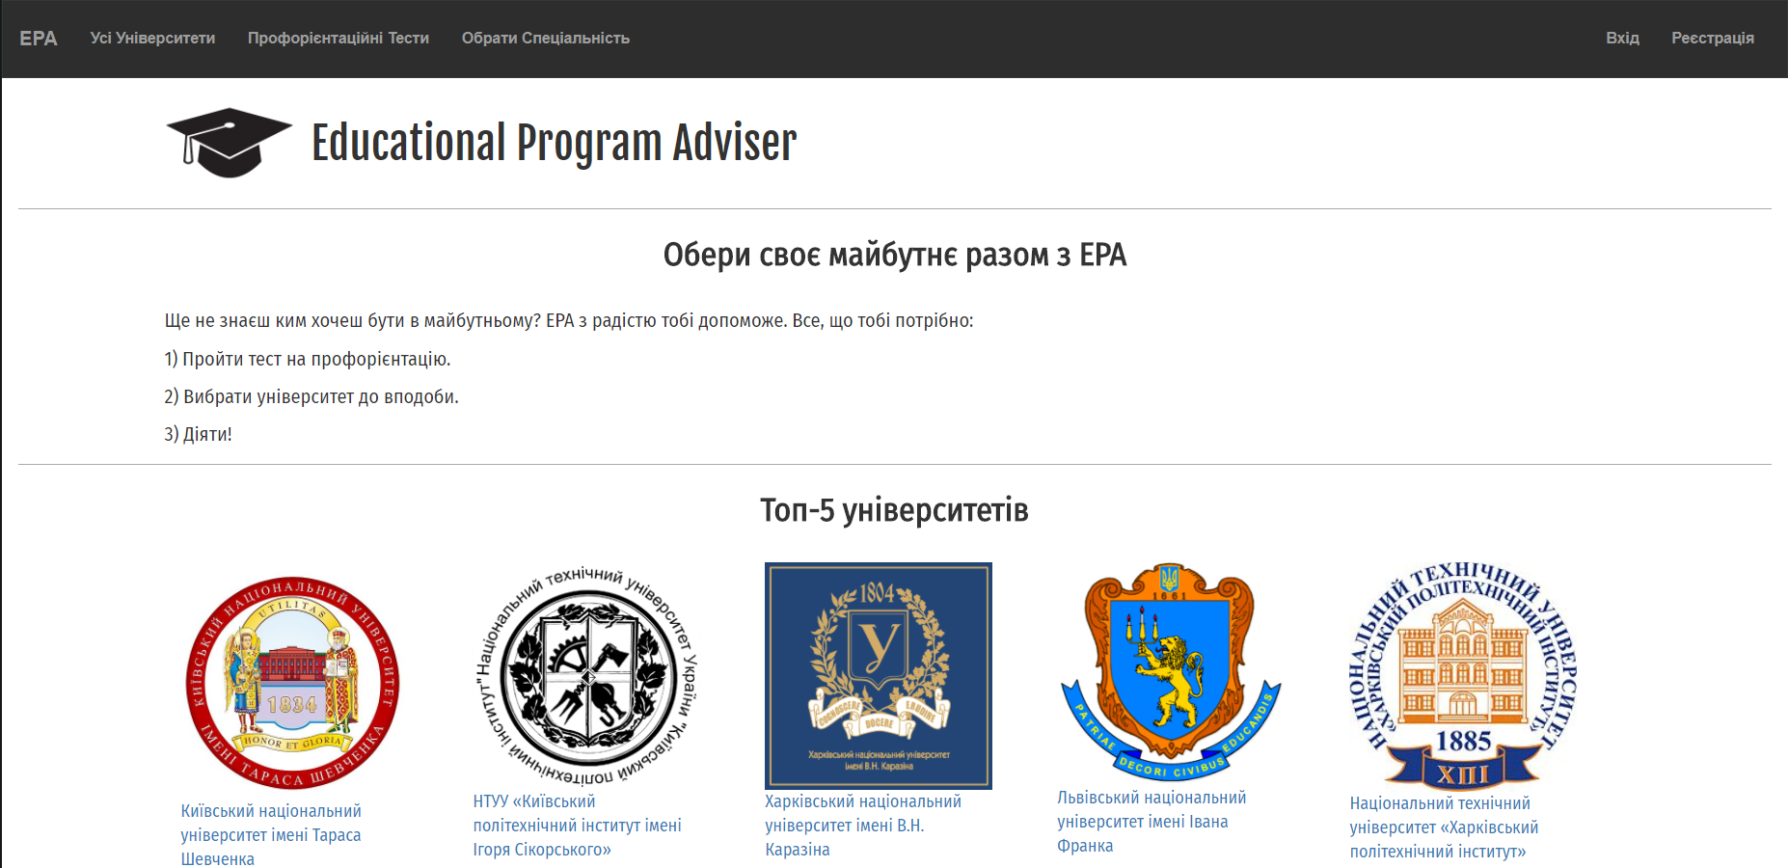
Nataliia
Home Page with 5 top universities

Slide 24
Nataliia
Top Universities
As a user I would like to see the top 5 universities on the start page:
in ETL download universities and information about them (including pictures);
create procedures for access on DB: GetTopUniversities(), GetLogoById(int id);
create methods on API;
create component on UI: Home.

Slide 25
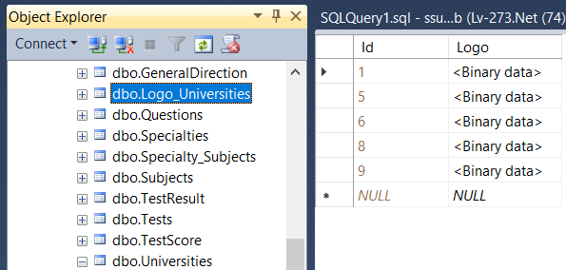
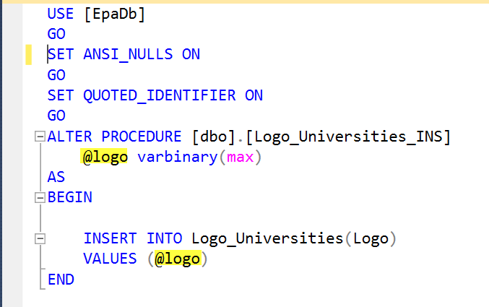
Nataliia
Table Logo_Universities and Stored Procedure in SQL Server 2014 Management Studio

Slide 26
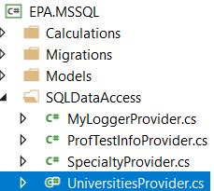
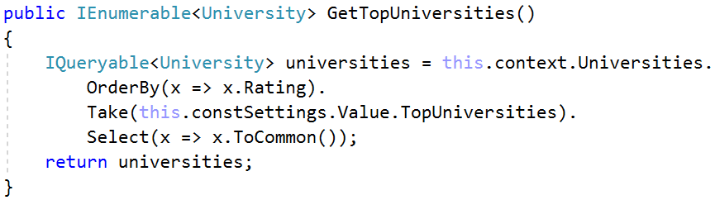
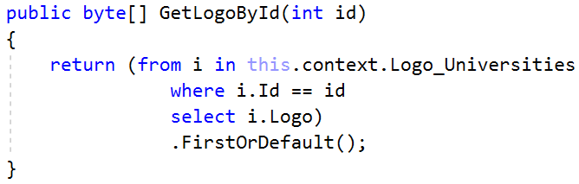
Nataliia
Universities Provider
S

Slide 27
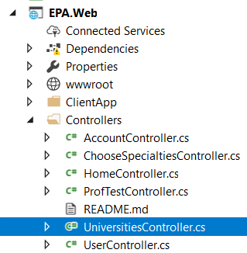
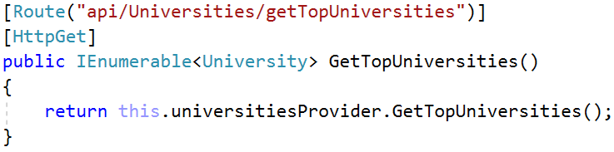
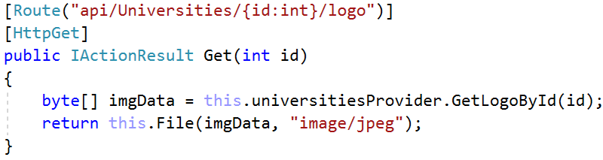
Nataliia
Universities Controller

Slide 28
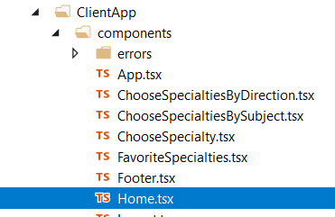
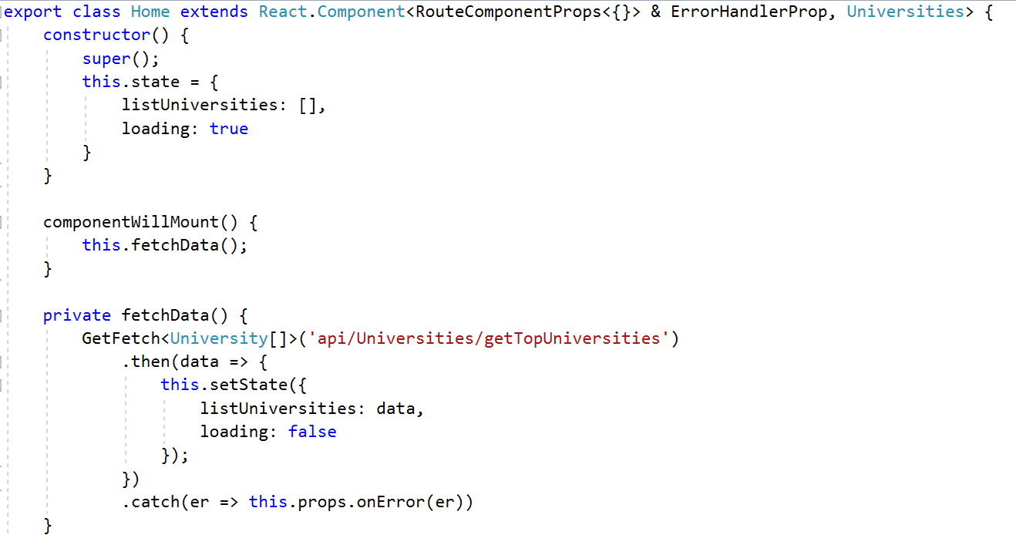
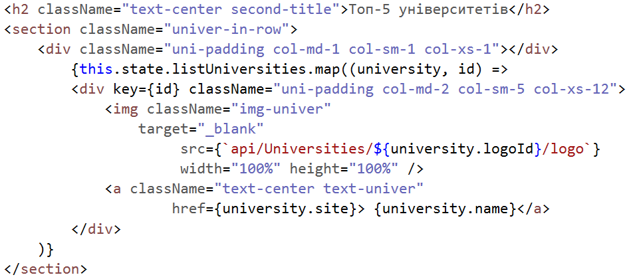
Nataliia
Home.tsx - Component of React

Slide 29
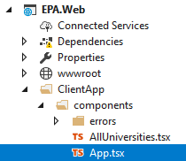
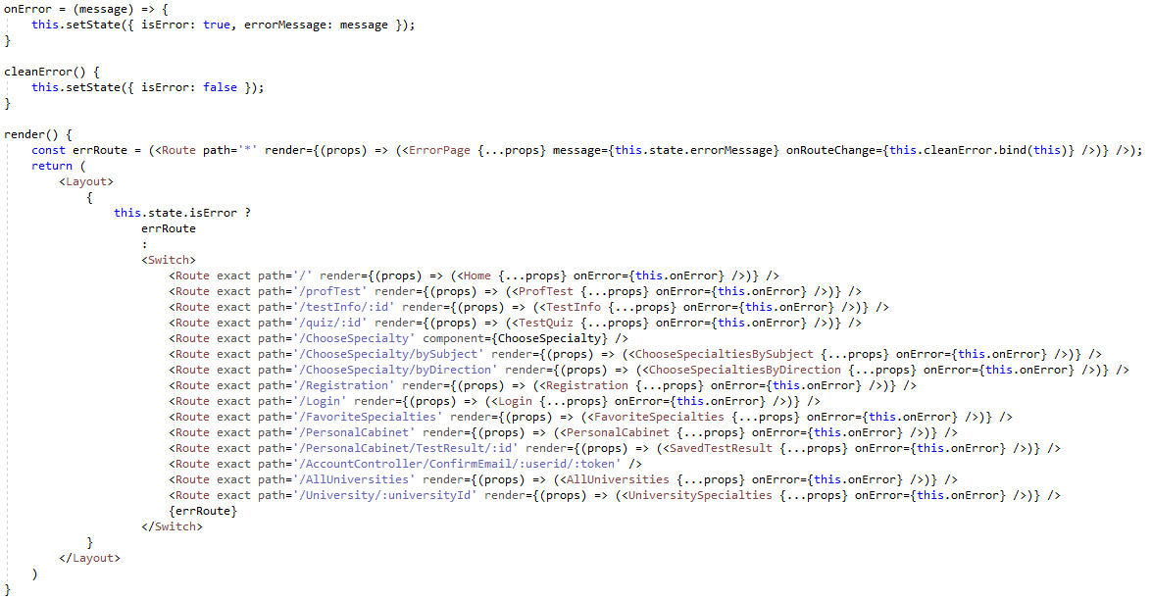
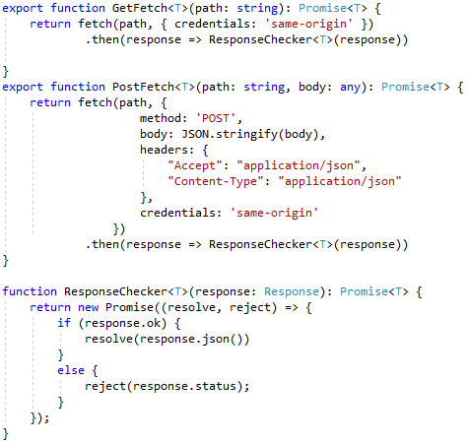
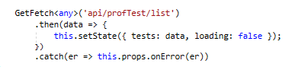
Vanya
App.tsx component

Slide 30
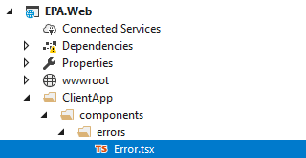


Vanya
Error.tsx component

Slide 31
Anastasiya
All Universities

Slide 32
Anastasiya
All universities
As a user I would like to view list of all universities in selected district
create method on DB that retrieves all universities in current district;
create methods on API;
create AllUniversities and UniversitySpecialties components on UI;

Slide 33



Iryna

Slide 34


Anastasiya
Method on DB that retrieves all universities in current district

Slide 35



Anastasiya
Method on API that retrieves all universities in current district

Slide 36


Anastasiya
React component for universities

Slide 37



Iryna
All Universities component

Slide 38

Anastasiya
Component on UI

Slide 39

Anastasiya
Component on UI

Slide 40


Anastasiya
Method on DB that retrieves specialties
of direction in university

Slide 41


Anastasiya
Method on API that retrieves all universities in current district

Slide 42


Anastasiya
React component for specialties

Slide 43
Anastasiya
Professional orientation test

Slide 44
Anastasiya
Professional orientation test
As a user I would like to pass professional orientation test and get result based on answers
create models to store
questions and answers
universities, specialties, directions and subjects;
create methods on DB to get questions and to get information about each direction;
create method on BL to calculate scores;
create methods on API;
create TestQuiz and Question components on UI;

Slide 45

Taras
Professional orientation test

Slide 46




Iryna
Test Information Model and DAL

Slide 47


Nataliia
Methods on API

Slide 48



Taras
Professional orientation test

Slide 49

Taras
Test detail component

Slide 50


Taras
Test Information React

Slide 51

Anastasiya
Component on UI

Slide 52


Anastasiya
Models to store questions and specialties

Slide 53


Anastasiya
Method on DB that returns a collection of questions for a specific test

Slide 54



Anastasiya
Method on API to get questions

Slide 55



Anastasiya
React component for questions

Slide 56


Anastasiya
Method on BL to calculate scores

Slide 57

Anastasiya
Method on DB that retrieves collection of all general directions from database

Slide 58



Anastasiya
Unit tests

Slide 59

Anastasiya
Get test result on API

Slide 60


Anastasiya
Get result on UI

Slide 61
Anastasiya
Component on UI

Slide 62


Iryna
Test Result page
………………

Slide 63

Taras
DB for Get Specialties

Slide 64



Iryna
Getting specialties by direction DAL

Slide 65


Vanya
Getting Authorized Specialties at MSSQL

Slide 66




Iryna
Rating Provider

Slide 67


Iryna
Getting specialties by direction API

Slide 68




Iryna
Test Result component

Slide 69

Iryna
Test Result component

Slide 70



Iryna
Test Result component

Slide 71
Iryna
Test Result page
………………

Slide 72

Vasya
Choose specialty by direction and district
As a user I would like to find specialty by direction in a concrete district
in ETL download specialties, universities and information about them;
create procedures for access on DB;
create methods on API: GetAllDistrict, GetSpecialtiesByDirection, GetGeneralDirection;
create component on UI

Slide 73


Nataliia

Slide 74



Nataliia

Slide 75


Nataliia
ListSpecialies

Slide 76

Nataliia

Slide 77



Andriy
Pagination

Slide 78

Andriy
Pagination

Slide 79
Vasya
Choose specialty by subjects and district
As a user I would like to find specialty by subjects in a concrete district
in ETL download specialties, universities and information about them;
create procedures for access on DB;
create methods on API: GetAllDistrict, GetSpecialtiesBySubjects, GetGeneralDirection;
create component on UI

Slide 80



Taras
Choose specialty by subjects DAL

Slide 81

Vasya
Choose specialty by subjects API

Slide 82



Vasya
Choose specialty by subjects REACT

Slide 83

Vasya

Slide 84

Andriy
Registration
As a user I would like to register, have my personal cabinet and save my favorite specialty there.

Slide 85



Andriy
Registration
…

Slide 86

Andriy
Registration

Slide 87


Andriy
Login

Slide 88

Anastasiya
Email

Slide 89


Anastasiya
Method on BL to send email

Slide 90


Anastasiya
Registration API

Slide 91

Anastasiya
Confirm email API

Slide 92

Andriy
Login

Slide 93

Iryna
Login API

Slide 94



Andriy
Login React

Slide 95

Andriy
Login React

Slide 96

Taras
Personal Cabinet

Slide 97


Vasya
Personal Cabinet DAL

Slide 98



Taras
Personal Cabinet API

Slide 99


Taras
Personal Cabinet React

Slide 100
Taras
Personal Cabinet - Change Password

Slide 101


Taras
Change Password

Slide 102


Taras
Change Password React

Slide 103

Taras
Personal Cabinet Tests Result

Slide 104

Vasya
DB models for Test Result

Slide 105


Vasya
Personal Cabinet add Tests Result

Slide 106


Vanya
Getting Saved Test Results DAL

Slide 107


Vanya
SavedTestResult.tsx component

Slide 108
Taras
Personal Cabinet – Favorite Specialties

Slide 109

Vasya
Favorite Specialties Models

Slide 110



Vasya
Favorite Specialties DAL

Slide 111

Vasya
Favorite Specialties DAL

Slide 112



Vanya
Favorites in ListSpecialties.tsx component

Slide 113



Taras
Favorite Specialties React

Slide 114

Taras
Favorite Specialties Page

Slide 115


